Slide 1

MAJOR PROJECT ON
SUBMITTED BY :
PAMIT DUGGAL (16BCA1440)
AMIT KASHYAP(16BCA1017)
Wi-Fi Based Mobile Quiz/Online Test(MCQ)

Slide 2
What is Android?
Operating Systems have developed a lot in last 15 years. Starting from black and white phones to recent smart phones or mini computers, mobile OS has come far away. Especially for smart phones, Mobile OS has greatly evolved from Palm OS in 1996 to Windows pocket PC in 2000 then to Blackberry OS and Android.

Slide 3
Android Applications:
Android applications are usually developed in the Java language using the Android Software Development Kit. Once developed, Android applications can be packaged easily and sold out either through a store such as Google Play or the Android applications are usually developed in the Java language using the Android Software Development Kit. Once developed, Android applications can be packaged easily and sold out either through a store such as Google Play Amazon Appstore.
Android powers hundreds of millions of mobile devices in more than 190 countries around the world. It's the largest installed base of any mobile platform and growing fast. Every day more than 1 million new Android devices are activated worldwide.

Slide 4
TECHNOLOGY USED:
Android software development kit
The Android software development kit (SDK) includes a comprehensive set of development tools. These include a debugger, libraries, a handset emulator based on QEMU, documentation, sample code, and tutorials. Currently supported development platforms include computers running Linux, Mac OS X 10.5.8 or later, and Windows XP or later. As of March 2015, the SDK is not available on Android itself, but the software development is possible by using specialized Android applications.

Slide 5
TECHNOLOGY USED (CONT.)
Java development kit
The Android build process depends on a number of tools from the JDK. Check out the build system overview documentation. The first big piece we need from JDK is
javac- all your source code written in Java needs to be compiled before it can be converted to the DEX format.
Once your code has been compiled, dexed, and packaged into an APK, we need jar signer to sign the APK.
There are some efforts out there to bring Java 8 features to Android, most notably gradle-retrolambda . Some of these require JDK 8 to compile properly.

Slide 6
SOFTWARE RESOURCE REQUIRMENT DOCUMENT:
Data Dictionary:
A set of information describing the contents, format, and structure of a database and the relationship between its elements, used to control access to and manipulation of the database.
Data Flow Diagram (DFD):
A data flow diagram (DFD) is a graphical representation of the "flow" of data through an information system, modelling its process aspects. A DFD is often used as a preliminary step to create an overview of the system. DFDs can also be used for the visualization of data processing.

Slide 7
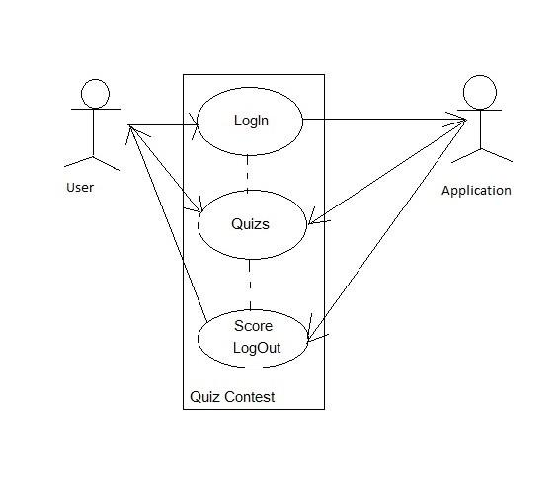
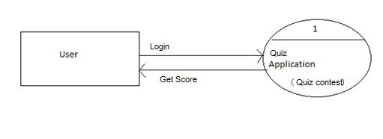
Diagrams:
Use Case Diagram:
Level 0 DFD:

Slide 8
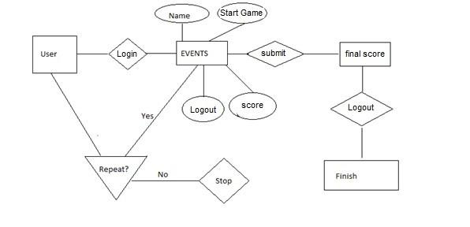
Er diagram:

Slide 9
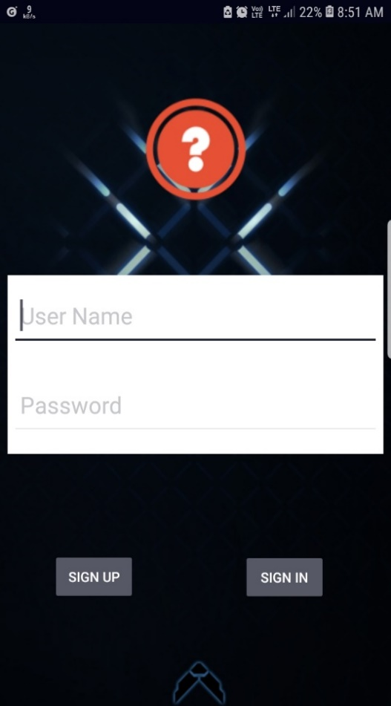
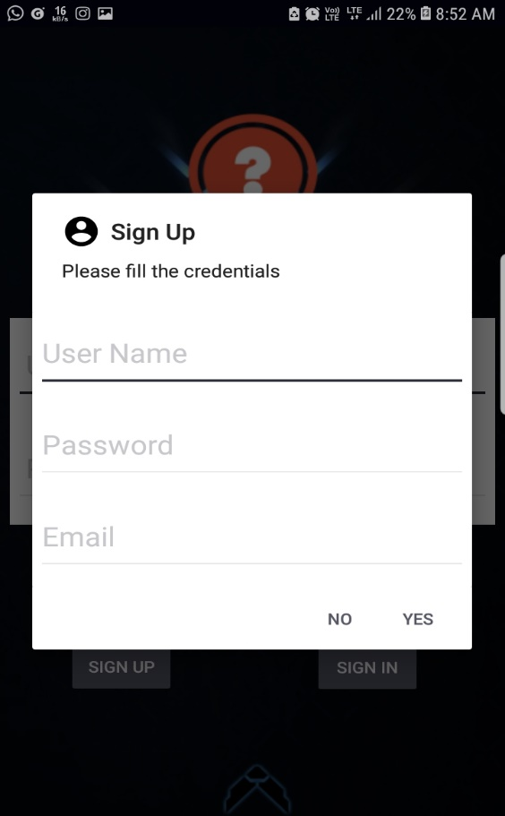
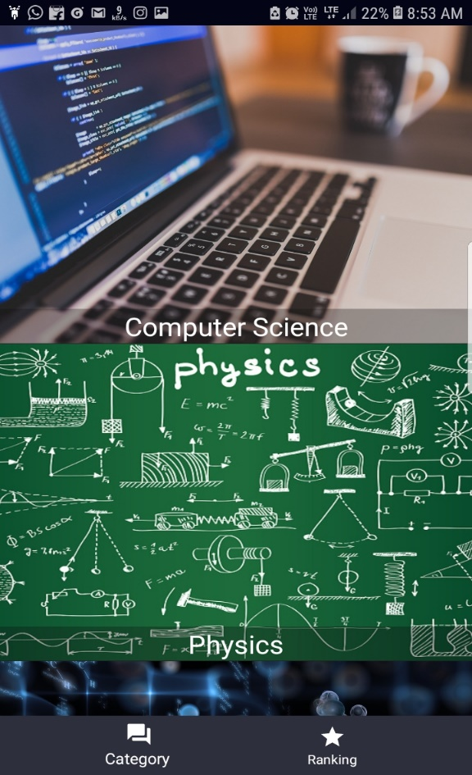
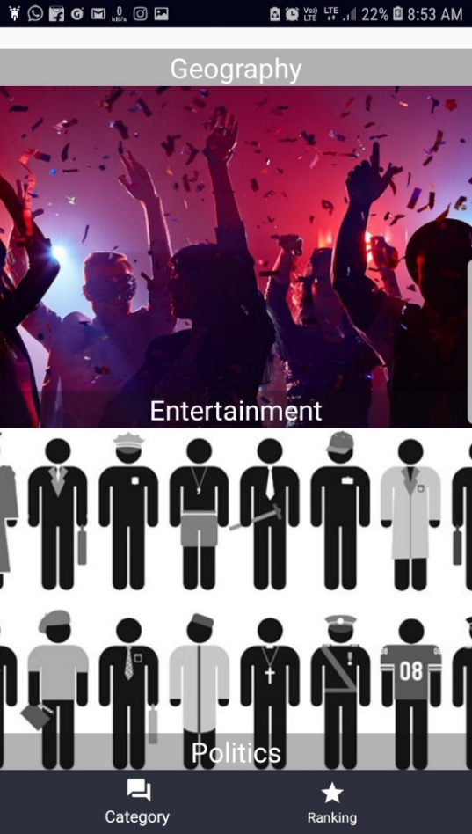
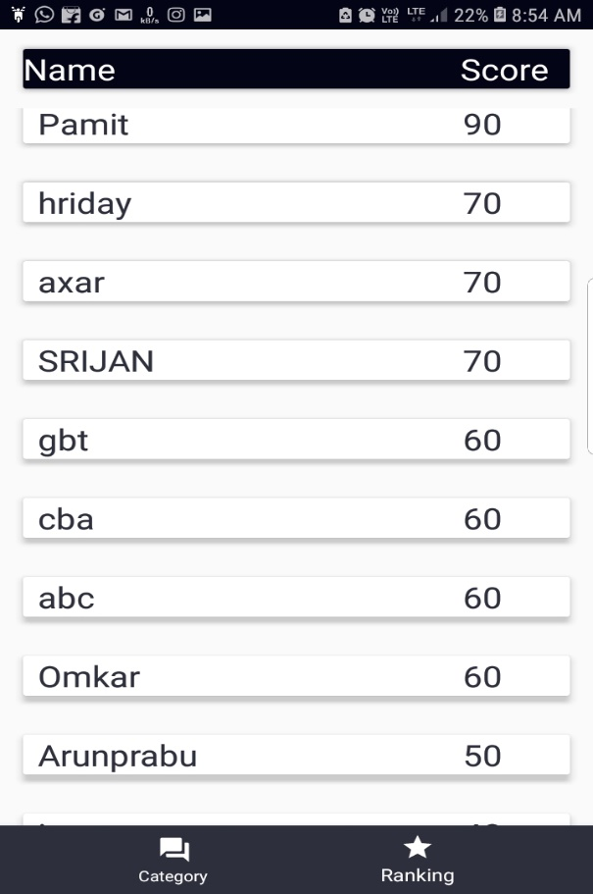
Screenshots:

Slide 10
Conclusion:
Currently there are many medication reminder systems which are operable manually. Due to increased manual work, the available system becomes more time consuming. So in the given work, an attempt has been made to implement fully automatic medication reminder system. It eases the user’s task of recalling when to take the medicine by reminding them of the particular medicine at the correct time thereby reducing the much prevalent manual work.

Slide 11
Bibliography:
www.google.com
www.stackoverflow.com
www.scripbd.com
www.slideshare.com
www.devloper.android.com
https://www.javatpoint.com/java-mail-api-tutorial
https://stacktips.com/tutorials/android/speech-to-text-in-android

Slide 12
Thankyou !!

